Slide 1
ICS Music Metadata Micro Service
Mayank Patel May 2024

Slide 2
Introduction
The Music Metadata Service organizes and enhances music data.
It simplifies artist and track management for streaming platforms.
Built with technologies like Spring Boot for efficiency.
Enables dynamic features like showcasing "Artist of the Day".
Aiming for seamless data integration and robust performance.

Slide 3
Technology Stack
Technologies
Supporting Technologies
Spring Boot
Database (JPA)
Mockito
TDD (Test-Driven Development)
Integration Testing
Java 21
Maven
JUnit 5 Jupiter
Hibernate
Docker
AWS
SonarQube
Swagger
Notes:
Spring Boot:
1. Spring Boot accelerates application development with its convention-over-configuration approach, simplifying setup and reducing boilerplate code.
2. Its embedded server capabilities streamline deployment, enabling seamless packaging and execution of standalone applications.
3. Spring Boot's extensive ecosystem provides robust support for building microservices and RESTful APIs, fostering rapid development and deployment.
Database (JPA):
1. Leveraging JPA, developers can abstract away database interactions, enhancing portability and scalability across different database systems.
2. JPA's object-relational mapping capabilities facilitate seamless communication between Java objects and relational databases, simplifying data access and manipulation.
3. With JPA's support for entity relationships and inheritance mapping, developers can model complex data structures with ease, ensuring efficient database management.
Mockito:
1. Mockito enables developers to mock dependencies and simulate behavior during unit testing, promoting isolation and test determinism.
2. Its intuitive API and fluent syntax facilitate the creation of mock objects, making it easy to define mock interactions and verify method invocations.
3. Mockito seamlessly integrates with testing frameworks like JUnit, enabling developers to write expressive and readable test cases for verifying component functionality.
TDD (Test-Driven Development):
1. Test-Driven Development (TDD) fosters a disciplined approach to software development by writing tests before implementing the corresponding functionality.
2. By focusing on test cases upfront, TDD encourages developers to clarify requirements and design interfaces, resulting in cleaner and more maintainable code.
3. TDD's iterative nature promotes code reliability and reduces the likelihood of defects, leading to higher overall software quality and faster development cycles.
Integration Testing:
1. Integration Testing validates interactions between various components of the system, ensuring seamless communication and functionality.
2. By testing the integration points between modules, Integration Testing detects defects early in the development lifecycle, reducing the risk of integration issues during deployment.
3. Automation tools like Postman and Swagger facilitate Integration Testing by providing frameworks for defining and executing test scenarios against RESTful APIs.
Java 21:
1. Java 21 introduces new language features and enhancements, offering improved performance, security, and productivity for developers.
2. With Java 21, developers can leverage modern programming paradigms and language constructs to write concise and expressive code, enhancing readability and maintainability.
3. Java 21's compatibility with existing Java libraries and frameworks ensures seamless migration and integration with legacy systems, maximizing code reuse and interoperability.
Maven:
1. Maven simplifies project management and build automation by providing a uniform structure for organizing dependencies and resources.
2. Its declarative approach to configuration streamlines the build process, enabling developers to define project settings and dependencies in a centralized pom.xml file.
3. Maven's extensive repository ecosystem offers a wide range of libraries and plugins, enhancing developer productivity and accelerating project development.
JUnit 5 Jupiter:
1. JUnit 5 Jupiter is a powerful testing framework for writing and executing unit tests in Java, providing a rich set of annotations and assertions for test case development.
2. Its modular architecture and extension model allow developers to customize test execution and integrate with other testing frameworks seamlessly.
3. With JUnit 5 Jupiter's support for parameterized tests and dynamic test generation, developers can write versatile and expressive test suites, ensuring comprehensive test coverage and thorough validation of code functionality.
Lombok:
1. Lombok simplifies Java development by reducing boilerplate code through the generation of getters, setters, and other common methods at compile time.
2. Its annotations enable developers to annotate fields and methods to automatically generate code, enhancing code conciseness and readability.
3. Lombok integrates seamlessly with popular IDEs and build tools like IntelliJ IDEA and Maven, providing a seamless development experience without sacrificing code quality or maintainability.
@Builder:
1. The @Builder annotation in Lombok generates a builder pattern for a class, allowing for fluent and expressive object instantiation without the need for manual builder implementation.
2. By automatically generating a builder class, @Builder simplifies object creation and configuration, improving code readability and reducing boilerplate code.
3. @Builder facilitates the construction of complex objects with optional and default values, providing flexibility and convenience in object initialization.
@Data:
1. The @Data annotation in Lombok generates standard boilerplate code for getter and setter methods, toString, equals, and hashCode, reducing code verbosity and improving code maintainability.
2. By automatically generating common data-related methods, @Data eliminates the need for manual implementation, saving development time and reducing the likelihood of errors.
3. @Data enhances code readability and conciseness, promoting best practices in object-oriented design and facilitating code comprehension and maintenance.
Diagrams:
1. Diagrams provide visual representations of system architecture, design, and data flow, aiding in understanding and communication among stakeholders.
2. Utilizing diagrams such as UML diagrams, ER diagrams, and flowcharts helps developers visualize complex systems and identify potential design flaws or improvements.
3. Diagrams serve as valuable documentation artifacts, capturing system components, interactions, and dependencies for future reference and collaboration.
Swagger:
1. Swagger is a powerful tool for designing, documenting, and testing RESTful APIs, providing a unified platform for API development and management.
2. With Swagger's intuitive interface and code-first approach, developers can define API specifications and generate interactive API documentation automatically.
3. Swagger's integration with various programming languages and frameworks streamlines API development, ensuring consistency and interoperability across different platforms.
Postman:
1. Postman is a popular API client that simplifies API development and testing by providing a user-friendly interface for sending requests, inspecting responses, and validating API behavior.
2. Its collection feature allows developers to organize and share API requests, making collaboration and testing workflows more efficient and manageable.
3. Postman's automation capabilities enable developers to create and execute test scripts, facilitating continuous integration and delivery processes for API-driven applications.
Rest API:
1. REST API (Representational State Transfer) is a software architectural style that defines a set of constraints for creating scalable and interoperable web services.
2. REST APIs use standard HTTP methods (GET, POST, PUT, DELETE) to perform CRUD (Create, Read, Update, Delete) operations on resources, promoting simplicity and uniformity in API design.
3. Leveraging RESTful principles, developers can build lightweight and flexible APIs that are easy to understand, maintain, and integrate with other systems.
End Points:
1. Endpoints are specific URLs (Uniform Resource Locators) within a web service that define access points for interacting with resources.
2. Each endpoint corresponds to a particular operation or resource, allowing clients to send requests
and receive responses via HTTP methods such as GET, POST, PUT, and DELETE.
3. Well-designed endpoints follow RESTful conventions and provide clear and intuitive access to application functionality, promoting ease of use and interoperability.
Global Exceptions:
1. Global Exceptions handling is a mechanism for centrally managing and processing runtime exceptions that occur throughout the application.
2. By defining a global exception handler, developers can centralize error handling logic, improving code maintainability and reducing redundancy in exception handling code.
3. Global Exceptions handling ensures consistent error responses across the application, enhancing user experience and facilitating troubleshooting and debugging efforts. Hibernate:
1. Hibernate is an object-relational mapping (ORM) framework for Java, simplifying database interactions by mapping Java objects to database tables.
2. It provides transparent persistence and caching mechanisms, improving application performance and scalability.
3. Hibernate supports various database vendors and configurations, offering flexibility and portability in application development.
Log4j:
1. Log4j is a widely-used logging library for Java, enabling developers to log messages at different levels of severity and categorize log output.
2. Its configuration options allow developers to customize logging behavior, including log output format, destination, and verbosity.
3. Log4j facilitates troubleshooting and debugging by providing detailed runtime information, helping developers identify and resolve issues efficiently.
H2 Database:
1. H2 Database is a lightweight, in-memory relational database engine for Java applications, offering fast and efficient data storage and retrieval.
2. It supports SQL syntax and provides JDBC API compatibility, making it easy to integrate with existing Java applications and frameworks.
3. H2 Database is commonly used for testing and prototyping purposes due to its simplicity, speed, and ease of setup.
AssertJ:
1. AssertJ is a Java library for fluent assertion statements in unit tests, providing expressive and readable assertions for verifying expected behavior.
2. Its rich set of assertion methods covers various data types and scenarios, enabling developers to write comprehensive and self-descriptive test cases.
3. AssertJ enhances test readability and maintainability, promoting best practices in test-driven development (TDD) and ensuring thorough validation of code functionality.
Spring Security:
1. Spring Security is a powerful authentication and access control framework for Java applications, providing robust security features and mechanisms.
2. It offers comprehensive security solutions for web and API-based applications, including authentication, authorization, session management, and CSRF protection.
3. Spring Security's modular architecture and integration with Spring Framework simplify security configuration and customization, ensuring application security best practices are implemented effectively.
Docker:
1. Docker is a containerization platform that enables developers to package applications and dependencies into lightweight, portable containers.
2. It provides isolated environments for running applications, improving consistency and reproducibility across different deployment environments.
3. Docker's container orchestration capabilities, such as Docker Compose and Kubernetes, facilitate deployment, scaling, and management of containerized applications in production environments.
AWS (Amazon Web Services):
1. AWS is a leading cloud computing platform that offers a wide range of services and tools for building, deploying, and managing applications and infrastructure.
2. It provides scalable and reliable cloud infrastructure services, including compute, storage, database, networking, and machine learning.
3. AWS offers flexible pricing models and global data center locations, enabling organizations to optimize costs and reach a global audience with their applications.
Jenkins:
1. Jenkins is an open-source automation server used for continuous integration (CI) and continuous delivery (CD) of software projects.
2. It automates the build, test, and deployment processes, enabling developers to deliver high-quality software faster and more reliably.
3. Jenkins integrates with various version control systems, build tools, and testing frameworks, providing a flexible and extensible CI/CD pipeline for diverse project requirements.
SonarQube:
1. SonarQube is a static code analysis tool used for assessing and improving code quality by identifying code smells, bugs, vulnerabilities, and security issues.
2. It provides actionable feedback and metrics on code quality, helping developers prioritize and address technical debt and maintainability issues.
3. SonarQube integrates with CI/CD pipelines, IDEs, and version control systems, enabling continuous code quality monitoring and improvement throughout the software development lifecycle.
Git:
1. Git is a distributed version control system (VCS) used for tracking changes in source code during software development.
2. It facilitates collaborative development by enabling multiple developers to work on the same codebase concurrently and manage changes efficiently.
3. Git provides features such as branching, merging, and version history tracking, enabling developers to collaborate, experiment, and revert changes with ease.

Slide 4
Features
Artist of the Day
1
Add New Track
4
Edit Artist Name
2
Fetch Artist Tracks
3
Notes:
1. Add New Track
- Users can easily add new tracks to an artist's catalogue.
- Capture track attributes like title, genre, and length.
2. Edit Artist Name
- Users have the ability to edit an artist's name.
- Accommodate instances where artists have multiple aliases.
3. Fetch Artist Tracks
- Users can fetch all tracks associated with a specific artist.
- Streamline access to an artist's entire discography.
4. Artist of the Day
- Users can view a different "Artist of the Day" on the homepage daily.
- Ensures a fair rotation through the entire artist catalogue.
- After cycling through all artists, the rotation restarts, providing equal exposure.
5. Cyclical Rotation
- The system ensures a cyclical rotation through all artists.
- Each artist gets an equal chance to be featured as the "Artist of the Day".
6. Efficient Backend Operations
- Backend operations are optimized for speed, reliability, and scalability.
- Ensures seamless handling of user requests and data management.

Slide 5
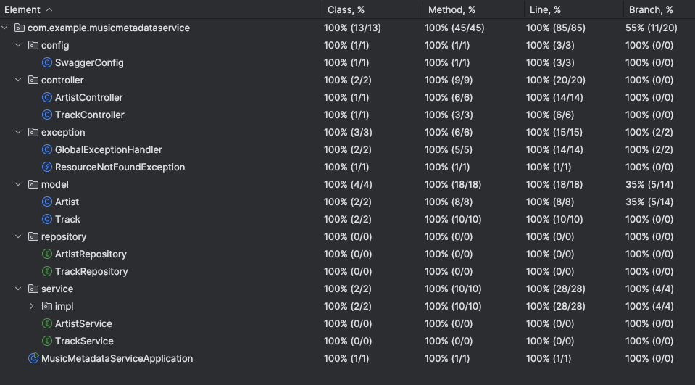
Code Coverage in Test-Driven Development (TDD)
Notes:
- Introduction to Code Coverage: Code coverage measures the proportion of code that is executed by automated tests. It provides insights into the effectiveness of test suites in exercising different parts of the codebase.
- Importance of Code Coverage: High code coverage indicates that a significant portion of the codebase is tested, reducing the likelihood of undiscovered bugs and enhancing overall software quality.
- Visualization of Code Coverage: Utilize tools such as JaCoCo or Cobertura to generate code coverage reports, highlighting areas of the code that are covered by tests and those that require additional testing.
- Benchmarking Code Coverage: Establish a target code coverage percentage based on project requirements and industry standards. Continuously monitor and improve code coverage to ensure comprehensive testing.
- Interpreting Code Coverage Results: Analyze code coverage reports to identify areas of low coverage and prioritize writing additional tests for critical or complex functionalities.
- Integration with CI/CD Pipeline: Integrate code coverage analysis into the CI/CD pipeline to automatically track coverage metrics and enforce coverage thresholds as part of the development workflow.

Slide 6
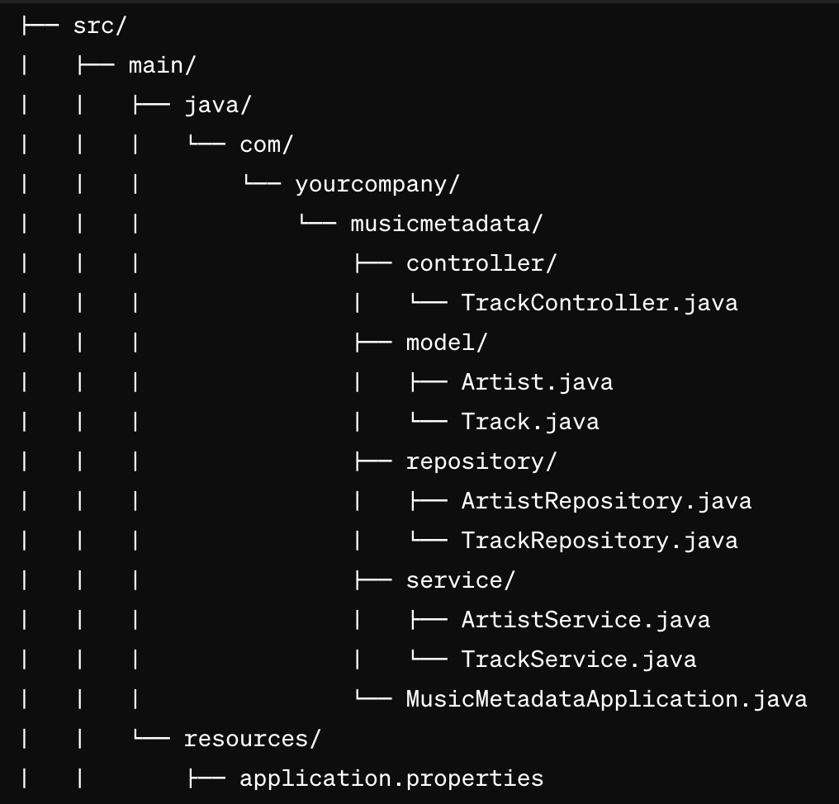
Directory Structure

Slide 7
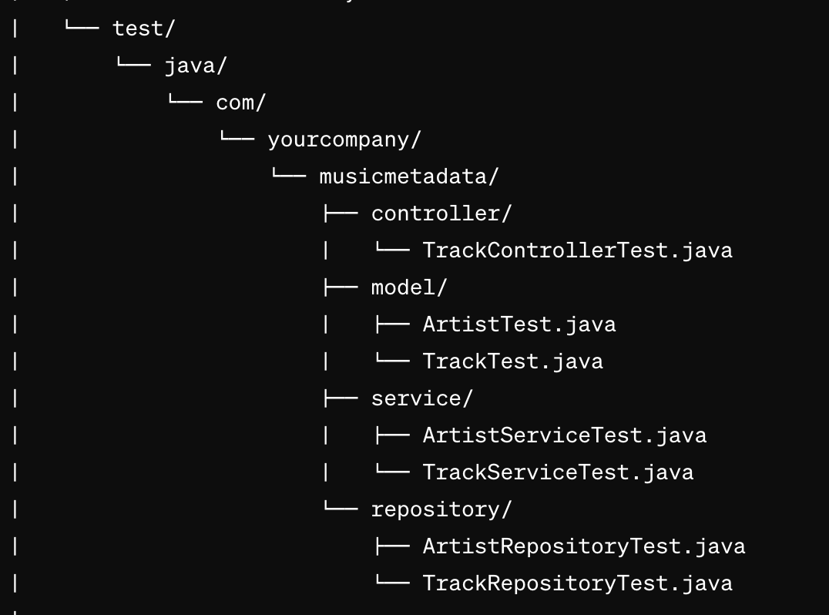
Directory Structure

Slide 8
Understanding Production-Ready Code
5
Monitoring tools are integrated into production-ready code to track system performance, detect anomalies, and ensure optimal operation, allowing for proactive maintenance and timely interventions.
4
It incorporates robust error handling mechanisms, logging functionalities, and security measures to protect against vulnerabilities and ensure data integrity.
Production-ready code adheres to best practices in software development, such as clean coding principles, modular design, and proper documentation.
3
It entails thorough testing, including unit tests, integration tests, and end-to-end tests, to validate functionality and identify potential issues before deployment.
2
1
Production-ready code refers to software that meets the standards and requirements necessary for deployment in a live environment, ensuring stability, reliability, and performance.
Notes:
- Definition: Production-ready code signifies software that has undergone rigorous testing and meets quality standards for deployment in a live environment.
- Testing: Emphasize the importance of comprehensive testing, covering unit tests to validate individual components, integration tests for interactions between modules, and end-to-end tests to verify system behavior.
- Best Practices: Discuss the adoption of best practices in coding, including modular design, adherence to coding standards, and comprehensive documentation to facilitate maintenance and collaboration.
- Error Handling and Security: Highlight the significance of robust error handling mechanisms and security measures to safeguard against potential issues and ensure data protection.
Automation: Explain the role of automation in the development process, particularly in continuous integration and deployment pipelines, to streamline testing, builds, and deployments for faster and more reliable releases.
Logging and Monitoring: Explain the role of logging functionalities and monitoring tools in production-ready code, enabling effective troubleshooting, performance optimization, and proactive maintenance.

Slide 9
Serverless Architecture
5
Reduced Operational Complexity: Serverless architecture simplifies operations by eliminating the need for tasks like server provisioning, patching, and maintenance. This reduces operational overhead, allowing teams to focus on building and improving the application instead of managing infrastructure.
4
Faster Time-to-Market: With serverless, we can deploy new features and updates quickly. Since we're not managing infrastructure, we can focus on writing code and delivering value to our users faster.
Cost-Efficiency: Serverless follows a pay-as-you-go model, where we only pay for the resources our code consumes during execution. This means we can optimize costs by scaling precisely to our needs, avoiding over-provisioning and idle resources.
3
Automatic Scaling: With serverless, our application can automatically scale up or down based on demand. This means we don't have to worry about capacity planning or provisioning servers to handle peak loads.
2
1
Simplified Management: Serverless means no more worrying about managing servers. Instead, we focus on writing code and let the cloud provider handle the rest. This frees up time and resources for more important tasks.
Notes:
Slide Title: Embracing Serverless Architecture
1. Simplified Management: Serverless means no more worrying about managing servers. Instead, we focus on writing code and let the cloud provider handle the rest. This frees up time and resources for more important tasks.
- Notes:
- Serverless is like renting a car instead of owning one. You don't need to maintain it; you just use it when you need it.
- Cloud providers like AWS offer services like Lambda, which let us run code without provisioning or managing servers.
- This simplicity reduces the overhead of infrastructure management, allowing developers to focus on writing code and delivering features faster.
2. Automatic Scaling: With serverless, our application can automatically scale up or down based on demand. This means we don't have to worry about capacity planning or provisioning servers to handle peak loads.
- Notes:
- Imagine a store that automatically opens more checkout counters during busy times and closes them when it's quiet. That's what serverless scaling does for our application.
- AWS Lambda, our serverless platform, handles scaling for us. It spins up more resources when needed and scales down to zero when there's no traffic.
- This ensures that our application can handle sudden spikes in traffic without any manual intervention, providing a seamless experience for users.
3. Cost-Efficiency: Serverless follows a pay-as-you-go model, where we only pay for the resources our code consumes during execution. This means we can optimize costs by scaling precisely to our needs, avoiding over-provisioning and idle resources.
- Notes:
- Serverless is like paying for electricity: you only pay for what you use. There's no need to keep servers running 24/7.
- AWS Lambda charges us based on the number of requests and the time our code runs. We don't pay for idle time, making it cost-effective for sporadic workloads.
- By leveraging serverless, we can reduce infrastructure costs while maintaining the flexibility to scale resources as our application grows.
4. Faster Time-to-Market: With serverless, we can deploy new features and updates quickly. Since we're not managing infrastructure, we can focus on writing code and delivering value to our users faster.
- Notes:
- Serverless allows us to iterate rapidly and experiment with new ideas without the overhead of provisioning servers.
- AWS Lambda supports continuous deployment, enabling us to automate the deployment process and deploy changes with confidence.
- By embracing serverless architecture, we can shorten our development cycles, respond to user feedback more quickly, and stay ahead of the competition. Sure, here's another point:
5. Reduced Operational Complexity: Serverless architecture simplifies operations by eliminating the need for tasks like server provisioning, patching, and maintenance. This reduces operational overhead, allowing teams to focus on building and improving the application instead of managing infrastructure.
- Notes:
- In a serverless model, cloud providers handle infrastructure management, including server provisioning, scaling, and maintenance, freeing up developers' time.
- This reduction in operational complexity streamlines the development process and lowers the risk of human error associated with manual infrastructure management tasks.
- With serverless, teams can allocate resources more efficiently, redirecting efforts towards innovation and delivering value to users rather than routine maintenance activities.

Slide 10
Scaling the System
Adding More Resources
Handling Growing Data
Improving Response Times
Modular Architecture
Elasticity and Flexibility
Notes:
Slide Title: Scaling the System
1. Adding More Resources: Scaling involves adding more resources, such as servers or services, to handle increased demand.
- Notes:
- To handle increased user traffic or workload, additional servers or services can be deployed.
- This approach, known as horizontal scaling, spreads the workload across multiple instances, enhancing performance and reliability.
- By adding more resources, the system can accommodate a larger number of concurrent users or requests without experiencing degradation in performance.
2. Handling Growing Data: Scalability also involves accommodating growing data volumes and ensuring optimal performance.
- Notes:
- Strategies like sharding and replication help distribute data across multiple database instances, improving query performance and fault tolerance.
- Scalable database solutions like Amazon Aurora or Google Cloud Spanner provide built-in features for automatic scaling and high availability.
- As the volume of data increases, it's essential to optimize database queries and indexing to maintain efficient data retrieval and storage.
3. Improving Response Times: Implementing caching mechanisms can reduce the load on backend services and improve response times.
- Notes:
- In-memory caching solutions like Redis or Memcached store frequently accessed data in memory, reducing the need to query the database for every request.
- Caching frequently accessed data helps improve scalability by reducing latency and improving overall system performance.
- By caching data closer to the application layer, response times can be significantly reduced, leading to a better user experience and higher throughput.
4. Modular Architecture: Adopting a modular architecture, such as microservices, can enhance scalability by breaking down the application into smaller, independently deployable components.
- Notes:
- Microservices architecture promotes modularity and autonomy, allowing teams to scale individual services independently based on demand.
- By decoupling components and isolating failure points, microservices architecture enhances fault tolerance and resilience, making it easier to scale specific components as needed.
- Each microservice can be developed, deployed, and scaled independently, allowing for better resource utilization and improved scalability across the system.
5. Elasticity and Flexibility: Scalable systems are elastic and flexible, allowing them to adapt to changing demand and allocate resources dynamically.
- Notes:
- Elasticity enables the system to automatically scale resources up or down based on traffic patterns, ensuring optimal performance and cost efficiency.
- Flexibility allows teams to scale components in response to changing requirements, providing agility and responsiveness to evolving business needs.
- By leveraging cloud computing resources and auto-scaling capabilities, the system can handle fluctuations in demand without manual intervention, ensuring seamless operation during peak periods.

Slide 11
Improving Project Efficiency: Tools and Techniques
07
Performance Optimization
06
Continuous Integration and Deployment (CI/CD)
Key Recommendations
05
Scalability and Elasticity
04
Advanced Logging and Monitoring
03
Caching Mechanisms
02
Enhanced Security Measures
01
Database Migration
Notes:
Certainly! Here's the revised list without bold characters:
1. Database Migration:
- Tools: AWS Database Migration Service (DMS), Flyway, Liquibase, PostgreSQL
- Explanation: By using tools like Flyway or Liquibase, we can easily manage database schema changes across different environments, ensuring smooth migration and version control. This helps in maintaining consistency and integrity in database structures.
- Continuation: AWS DMS facilitates seamless migration of data between different database engines, reducing downtime and minimizing risks during the migration process.
- Continuation: PostgreSQL offers robust features for managing relational data and is often preferred for its scalability and performance in production environments.
- Continuation: With proper database migration strategies, we can ensure data integrity and minimize the impact of schema changes on application functionality.
- Continuation: These tools automate the migration process, making it easier to deploy database changes across development, testing, and production environments.
2. Enhanced Security Measures:
- Tools: Auth0, Okta, AWS Cognito, Keycloak, Spring Security
- Explanation: Implementing Spring Security or using services like AWS Cognito enhances user authentication and authorization, safeguarding the application from unauthorized access. This strengthens the overall security posture of the system.
- Continuation: Solutions like Auth0 or Okta provide comprehensive identity management and authentication services, offering features like multi-factor authentication and single sign-on (SSO) capabilities.
- Continuation: AWS Cognito integrates seamlessly with AWS services, providing scalable user authentication and access control for web and mobile applications.
- Continuation: Keycloak is an open-source identity and access management platform that offers fine-grained authorization policies and user federation capabilities.
- Continuation: With these security tools in place, we can enforce security best practices, mitigate common vulnerabilities, and protect sensitive data from unauthorized access.
3. Caching Mechanisms:
- Tools: Redis, Memcached, Amazon ElastiCache, Hazelcast, Apache Ignite
- Explanation: Tools like Redis or Memcached help improve application performance by caching frequently accessed data, reducing the need for repeated database queries. This results in faster response times and better scalability.
- Continuation: Amazon ElastiCache provides fully managed Redis and Memcached services in the cloud, offering high availability and low-latency data access for caching purposes.
- Continuation: Solutions like Hazelcast or Apache Ignite offer distributed caching capabilities, allowing data to be stored in-memory across multiple nodes for improved performance and resilience.
- Continuation: Caching mechanisms can be strategically implemented to cache static content, database query results, or session data, depending on the application's requirements.
- Continuation: By reducing the load on the backend database and improving data access speeds, caching mechanisms contribute to overall system scalability and responsiveness.
4. Advanced Logging and Monitoring:
- Tools: ELK Stack, CloudWatch Logs, Splunk, Grafana, Prometheus
- Explanation: With tools like ELK Stack or CloudWatch Logs, we can monitor application behavior in real-time, identify issues, and analyze logs to ensure system stability. This enables proactive monitoring and troubleshooting of potential issues before they impact users.
- Continuation: ELK Stack (Elasticsearch, Logstash, Kibana) offers a comprehensive log management solution, allowing centralized log collection, parsing, and visualization for detailed analysis and troubleshooting.
- Continuation: CloudWatch Logs provides native logging capabilities for AWS services, allowing log aggregation, monitoring, and alerting based on predefined metrics and thresholds.
- Continuation: Splunk offers a powerful platform for log analysis, data visualization, and real-time monitoring, enabling deep insights into application performance and security events.
- Continuation: By integrating monitoring tools like Grafana or Prometheus, we can create custom dashboards, set up alerts, and gain visibility into system metrics, application health, and performance trends.
5. Scalability and Elasticity:
- Tools: AWS Lambda, Amazon API Gateway, DynamoDB Streams, Kubernetes, Docker Swarm
- Explanation: Leveraging services like AWS Lambda or Kubernetes allows the application to dynamically scale based on demand, ensuring optimal performance during peak loads. This enables the system to handle fluctuations in traffic and maintain responsiveness under varying workloads.
- Continuation: AWS Lambda enables serverless execution of code in response to events, automatically scaling resources based on incoming requests without the need for manual intervention.
- Continuation: Kubernetes provides container orchestration capabilities, allowing automatic scaling of application instances based on resource utilization metrics and defined scaling policies.
- Continuation: Docker Swarm simplifies container deployment and management, offering built-in scaling features for distributing application workloads across multiple nodes.
- Continuation: By adopting scalable infrastructure solutions like AWS API Gateway or DynamoDB Streams, we can ensure that the application architecture is designed to handle growing user demand and maintain high availability and performance levels. Certainly! Continuing from the previous response:
6. Continuous Integration and Deployment (CI/CD):
- Tools: Jenkins, GitLab CI/CD, CircleCI, Travis CI, GitHub Actions
- Explanation: Implementing CI/CD pipelines with tools like Jenkins or GitLab CI/CD automates the software delivery process, enabling frequent code deployments, testing, and integration. This accelerates the development cycle and ensures rapid delivery of new features and bug fixes to production.
- Continuation: Jenkins is a widely used automation server that supports continuous integration and delivery, allowing developers to build, test, and deploy code changes automatically.
- Continuation: GitLab CI/CD offers built-in CI/CD capabilities integrated with version control, enabling seamless automation of the software delivery pipeline from code commit to deployment.
- Continuation: CircleCI and Travis CI are cloud-based CI/CD platforms that provide scalable and customizable workflows for automating software builds, tests, and deployments across various environments.
- Continuation: GitHub Actions enables automation of workflows directly within GitHub repositories, allowing developers to automate tasks such as code compilation, testing, and deployment using preconfigured or custom actions.
7. Containerization with Docker:
- Tools: Docker, Docker Compose, Kubernetes, AWS ECS, Google Kubernetes Engine (GKE)
- Explanation: Docker containers provide lightweight, portable environments for deploying and running applications consistently across different platforms. With tools like Docker Compose or Kubernetes, we can manage containerized applications efficiently, improving scalability, resource utilization, and deployment flexibility.
- Continuation: Docker simplifies application deployment by packaging code, runtime, libraries, and dependencies into a single container image, ensuring consistency and reproducibility across development, testing, and production environments.
- Continuation: Docker Compose allows defining multi-container applications using a simple YAML file, facilitating the setup and management of complex application stacks with interconnected services.
- Continuation: Kubernetes orchestrates containerized applications, automating deployment, scaling, and management tasks, and providing features like service discovery, load balancing, and rolling updates for containerized workloads.
- Continuation: AWS ECS (Elastic Container Service) and Google Kubernetes Engine (GKE) are managed container orchestration services offered by cloud providers, allowing seamless deployment and management of containerized applications at scale in a cloud environment.
8. Infrastructure as Code (IaC):
- Tools: Terraform, AWS CloudFormation, Ansible, Puppet, Chef
- Explanation: Infrastructure as Code (IaC) allows defining and provisioning infrastructure resources using code, enabling automated and repeatable infrastructure deployment and management. Tools like Terraform or AWS CloudFormation simplify infrastructure provisioning, configuration, and scaling, improving efficiency and consistency in infrastructure management.
- Continuation: Terraform provides a declarative language for defining infrastructure resources as code, allowing infrastructure provisioning across various cloud providers and on-premises environments with version-controlled configuration files.
- Continuation: AWS CloudFormation offers a native IaC service for defining and managing AWS resources using JSON or YAML templates, enabling automated provisioning, updates, and deletion of infrastructure stacks.
- Continuation: Ansible, Puppet, and Chef are configuration management tools that automate the deployment and configuration of infrastructure components, ensuring consistency and compliance with defined configurations across servers and environments.
- Continuation: By adopting IaC practices and tools, we can achieve infrastructure automation, reduce manual intervention, and increase the agility and reliability of infrastructure deployments, leading to faster time-to-market and improved operational efficiency.
9. Security Enhancements:
- Tools: OWASP ZAP, SonarQube, HashiCorp Vault, Nessus, Snort
- Explanation: Strengthening security measures is crucial for protecting the application against vulnerabilities and cyber threats. Utilizing tools like OWASP ZAP or SonarQube enables automated security testing and vulnerability scanning, while solutions like HashiCorp Vault help manage sensitive information securely.
- Continuation: OWASP ZAP (Zed Attack Proxy) is a widely used security tool for finding vulnerabilities in web applications through automated scanning and manual testing, helping identify and mitigate security risks.
- Continuation: SonarQube provides continuous code quality analysis and security scanning, highlighting security vulnerabilities, code smells, and bugs in the codebase, enabling developers to address security issues early in the development process.
- Continuation: HashiCorp Vault offers secure storage and management of sensitive data such as API keys, passwords, and encryption keys, providing a centralized platform for secret management and access control.
- Continuation: Nessus and Snort are network security tools used for vulnerability assessment and intrusion detection, helping detect and respond to security threats in real-time, safeguarding the application infrastructure and data against cyber attacks.
10. Performance Optimization:
- Tools: JProfiler, Apache JMeter, New Relic, Prometheus, Grafana
- Explanation: Optimizing application performance is essential for ensuring responsiveness, scalability, and reliability under various load conditions. Tools like JProfiler or Apache JMeter enable performance profiling and load testing, while solutions like New Relic and Prometheus provide monitoring and analytics for identifying performance bottlenecks.
- Continuation: JProfiler is a Java profiler that helps identify performance issues by analyzing CPU usage, memory consumption, and thread behavior in Java applications, allowing developers to optimize code for better performance.
- Continuation: Apache JMeter is a popular load testing tool used for simulating user traffic and measuring application performance under different load levels, helping identify performance limitations and scalability concerns.
- Continuation: New Relic offers application performance monitoring (APM) solutions that provide real-time insights into application performance, infrastructure health, and user experience, enabling proactive monitoring and troubleshooting of performance issues.
- Continuation: Prometheus is an open-source monitoring and alerting toolkit designed for capturing and querying application metrics, while Grafana complements Prometheus by visualizing metrics and creating dashboards for performance analysis and monitoring.

Slide 12
Deploying Spring Boot with Docker: A Step-by-Step Guide
Build Docker Image
1
docker build -t music-metadata-service .
Run Docker Container
2
docker run -p 8080:8080 music-metadata-service
Access Swagger Documentation
3
http://localhost:8080/swagger-ui/index.html
Install Postman Collection
4
/music-metadata-service/Doc/PostManCollections /Music MetaData Service Collection.postman_collection.json
Notes:
1. Build Docker Image:
- Use the command `docker build -t music-metadata-service .` to construct a Docker image named `music-metadata-service`. This command leverages the Dockerfile located in the current directory (`.`) to create the image.
2. Run Docker Container:
- Execute `docker run -p 8080:8080 music-metadata-service` to initiate a Docker container based on the `music-metadata-service` image. This command binds port `8080` of the container to port `8080` of the host machine (`-p 8080:8080`), facilitating access to the application.
3. Access Swagger Documentation:
- Open your web browser and navigate to `http://localhost:8080/swagger-ui/index.html` to access the Swagger documentation. This URL showcases the comprehensive documentation for the RESTful APIs offered by the Spring Boot application.
4. Install Postman Collection:
- Download the provided Postman collection from `/Users/mpatel/JavaProjects/music-metadata-service/Docs/PostManCollections/Music MetaData Service Collection.postman_collection.json`.
- Import this collection into Postman to gain access to pre-configured requests for testing various endpoints of the Spring Boot application.
- Utilize the imported collection to interact with the project's endpoints seamlessly during testing and development.

Slide 13
Conclusions & Findings
01
In conclusion, the successful deployment of the music-metadata-service project demonstrates the seamless integration of Spring Boot with Docker, facilitating efficient containerization and deployment of Java applications. By following the provided commands and instructions, developers can easily build, run, and interact with the project within a Docker environment.
02
Furthermore, the project's integration with Swagger enables comprehensive documentation of the RESTful APIs, enhancing clarity and facilitating seamless interaction with the application endpoints. The provided Postman collection offers a convenient way to test and validate the functionality of the project's endpoints, ensuring reliability and robustness.
03
Overall, the music-metadata-service project exemplifies best practices in containerization, documentation, and API testing, empowering developers to efficiently develop, deploy, and maintain Java-based microservices. Through the adoption of Docker, Swagger, and Postman, the project underscores the importance of embracing modern development tools and methodologies to achieve agility, scalability, and reliability in software development projects.

Slide 14
Demo & Code

Slide 15
Discuss & Questions

